Slide 1
Mongo DB
By:Umer Farooq

Slide 2
Python can be used in database applications.
One of the most popular NoSQL database is MongoDB.

Slide 3
MongoDB
MongoDB stores data in JSON-like documents, which makes the database very flexible and scalable.
To be able to experiment with the code examples in this tutorial, you will need access to a MongoDB database.
You can download a free MongoDB database at https://www.mongodb.com.

Slide 4
db

Slide 5
Listing databases
show databases
Currently have four databases. They are: CrudDB, admin, config and local.

Slide 6
Go to a particular database
use <your_db_name>
Here I’ve moved to the local database. You can check this if you try the command db to print out the current database name.

Slide 7
Creating a Database
With RDBMS (Relational Database Management Systems) we have Databases, Tables, Rows and Columns.
But in NoSQL databases, such as MongoDB, data is stored in BSON format (a binary version of JSON). They are stored in structures called “collections”.

Slide 8
use <your_db_name>
In MongoDB server, if your database is present already, using that command will navigate into your database.
But if the database is not present already, then MongoDB server is going to create the database for you. Then, it will navigate into it.
After creating a new database, running the show database command will not show your newly created database. This is because, until it has any data (documents) in it, it is not going to show in your db list.

Slide 9
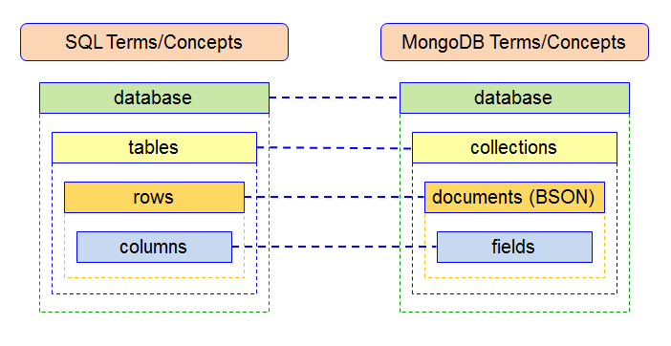

Slide 10
Creating a Collection
Navigate into your newly created database with the use command.
One way is to insert data into the collection:
db.myCollection.insert({"name": "john", "age" : 22, "location": "colombo"})

Slide 11
Inserting Data
We can insert data to a new collection, or to a collection that has been created before.
There are three methods of inserting data.
insertOne() is used to insert a single document only.
insertMany() is used to insert more than one document.
insert() is used to insert documents as many as you want.

Slide 12
insertOne()
db.myCollection.insertOne(i { "name": "navindu", "age": 22 })

Slide 13
insertMany()
db.myCollection.insertMany([ { "name": "navindu", "age": 22 },
{ "name": "kavindu", "age": 20 }, { "name": "john doe", "age": 25, "location": "colombo"}
])

Slide 14
Querying Data
Here’s how you can query all data from a collection:
db.myCollection.find()
db.myCollection.find({})

Slide 15
Updating documents
db.myCollection.update({age : 20}, {$set: {age: 23}})

Slide 16
Removing a document
db.myCollection.remove({name: "navindu"});
db.myCollection.remove({});
For complete collection

